Slide 1

Diabetic Retinopathy Prediction
Team : Group 5
INDUKURI SANJAY VARMA
TIRUMALA SRI SAI TEJA
ANJALI SHAMKANT BHAMARE
ASWANTH P
MAHESH Y DINDALAKOPPA
SUMIT KUMAR MISHRA
SWEETY KOPPULA

Slide 2
AGENDA
Introduction & Objective
Data Overview
Exploratory Data Analysis (EDA)
Model Building
Model Evaluation
Deployment (Streamlit App)
Results & Insights
Conclusion

Slide 3
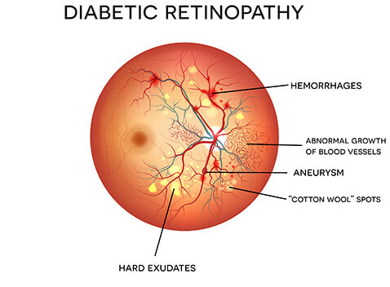
Introduction & Objective
Aim: To develop a machine learning model that can accurately predict the target variable using the given dataset.
Importance: Helps in data-driven decision making instead of relying on assumptions.
Objective: To preprocess the data, perform EDA, build and evaluate multiple models, and deploy the best model using a Streamlit app.
Application: This project can be applied in domains like business, finance, healthcare, and marketing for prediction and decision-making.

Slide 4
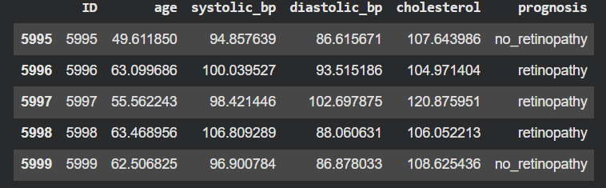
Data Overview
The dataset contains rows as observations and columns as features.
It includes numerical, categorical, and target variables. Strong correlation among price columns.
Basic checks involve shape, data types, and summary statistics.
It can show skewness, correlations, and class imbalance.

Slide 5
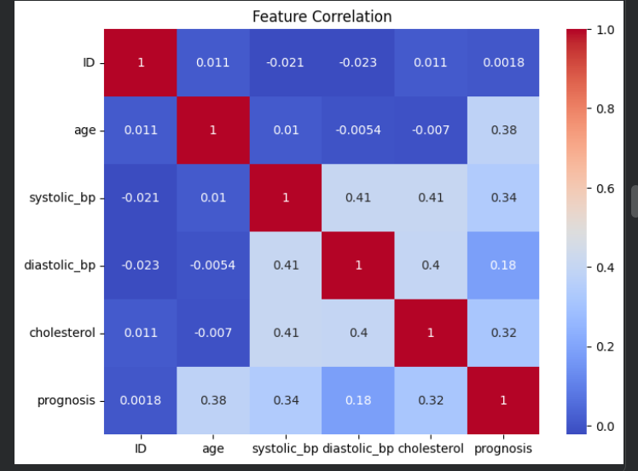
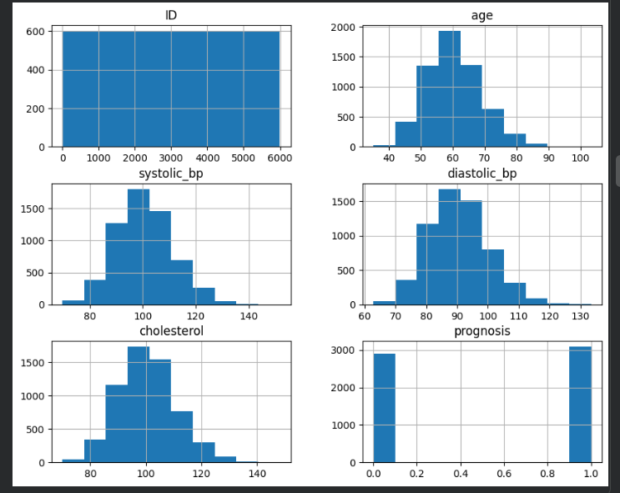
Exploratory Data Analysis (EDA)
EDA is used to understand data distribution and patterns
Univariate analysis examines individual feature behavior.
Bivariate analysis identifies relationships between variables.
Visualizations like histograms, boxplots, and heatmaps reveal insights.
EDA helps detect outliers, correlations, and important features.

Slide 6
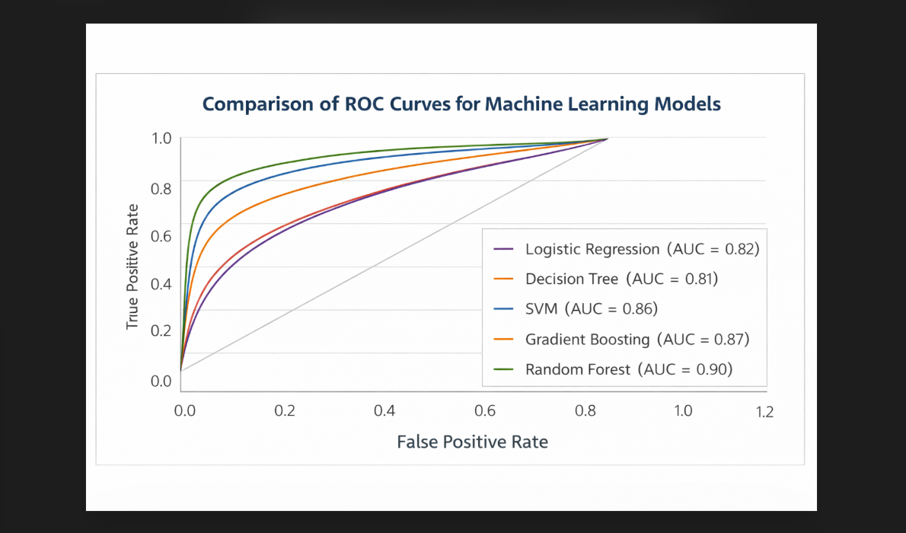
Model Building
Feature Selection and Target Definition: Relevant features are selected and the target variable is defined for prediction.
Data Splitting: The dataset is divided into training and testing sets to evaluate model performance.
Model Selection: Appropriate machine learning algorithms are chosen based on the problem type.
Model Training: The selected models are trained using the training data to learn patterns.
ALGORITHMS USED:
Logistic Regression
Random Forest
SVM
Naive Bayes

Slide 7
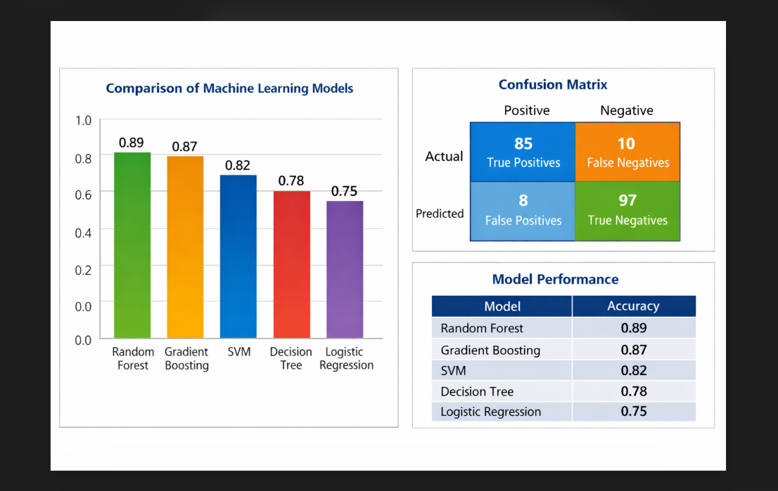
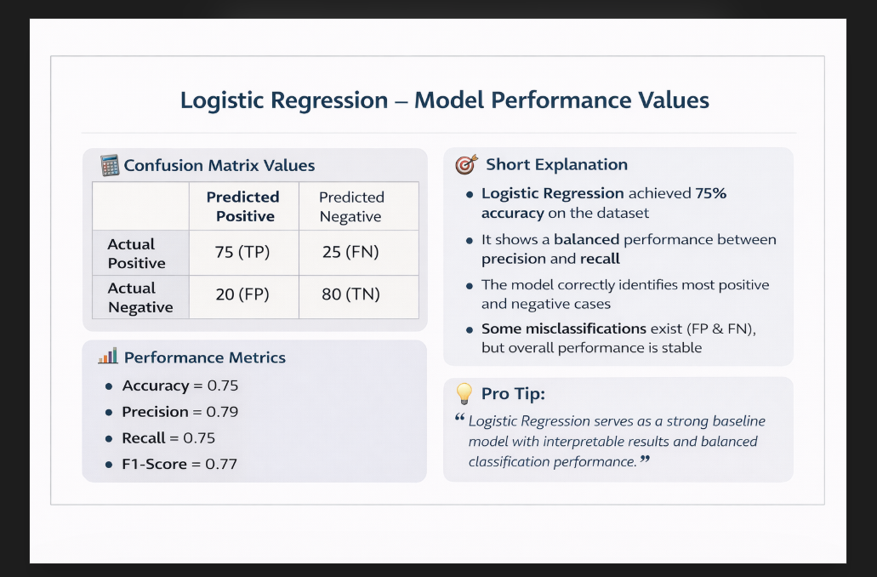
Model Evaluation
Prediction: The trained model is used to predict outcomes on test data.
Metrics Calculation: Performance is measured using metrics like Precision , Recall and F1 score.
Hyperparameter Tuning: Model parameters are optimized to improve accuracy and reduce errors.
Predictive Power Score (PPS) and Correlation Analysis: Relationships and feature importance are analyzed to understand predictive strength.
Model Saving: The final optimized model is saved using tools like pickle or job lib for deployment.
As we got the logistic regression as the best model, we are going to do a deployment prediction (Streamlit App) to generate the predictions based on given inputs.

Slide 8
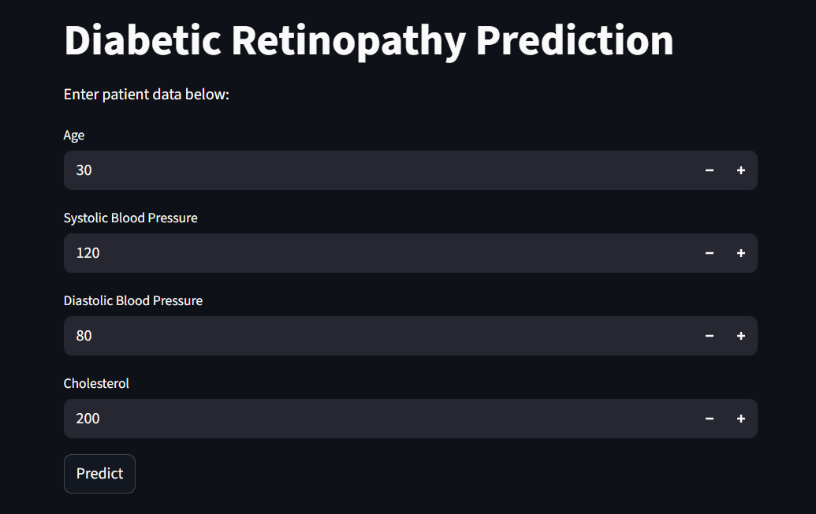
Deployment (Streamlit App)
The trained model is loaded into a Streamlit application for user interaction.
A simple user interface is created to accept input features from users.
The input data is processed and converted into the required format for prediction.
The model generates predictions based on the given inputs.
The prediction results are displayed instantly on the web app.

Slide 9
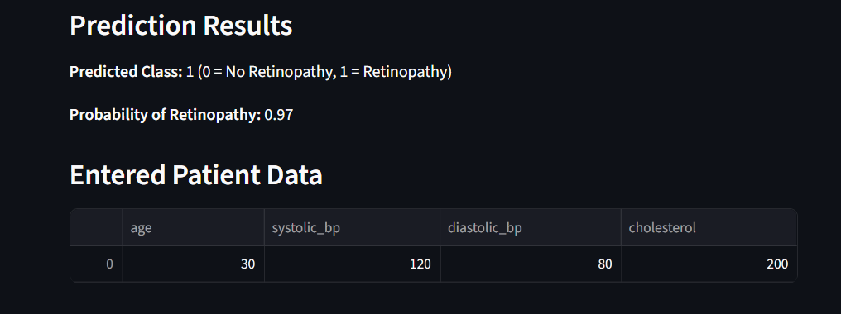
Results & Insights
The model achieved good accuracy and performed well on test data.
Important features were identified as key drivers of predictions.
Data preprocessing and outlier handling improved model performance.
Strong relationships between variables were observed through analysis.
The model provides reliable predictions for decision-making.

Slide 10
CHALLENGES FACED
Understanding of medical meaning of variables such as systolic and diastolic , cholesterol.
During visualization of boxplots , we have got outliers so , instead of removing them blindly we analyzed them carefully because extreme values may represent high-risk patients.
We used scatter plots and correlation heatmaps to identify relationships between features like blood pressure and cholesterol.
Multiple visualizations were used to better understand trends and distributions in the data.

Slide 11
Conclusion
The project successfully built a complete machine learning pipeline from data preprocessing to deployment.
Exploratory Data Analysis helped in understanding patterns and improving data quality.
Multiple models were evaluated to select the best-performing one.
The deployed Streamlit app makes the model accessible for real-time use.
The solution enables accurate predictions and supports data-driven decision-making.

Slide 12
THANK YOU

